Slide 1
Wrap up
Quan Nguyen

Slide 2
To do
Upload codebase to github
Must show motivation: through SOP (curious and preservation), personal project relating to music?
Always make some progress (small and big)

Slide 3
Weekly Report
(week 9-10)
Quan Nguyen

Slide 4
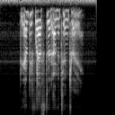
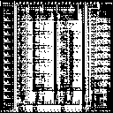

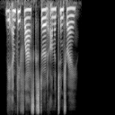
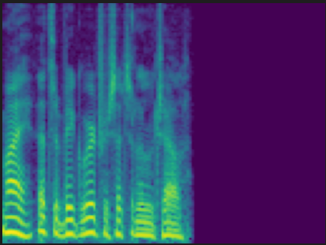
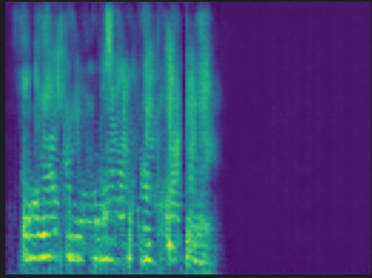
Week 9
Fixed last week issue by normalizing the spectrogram before training
input
Step 40000
Step 990000
output

Slide 5
Week 9
Combine new dataset into the old one
Total PD and OC: ~1400 files
Transcribe using Whisper-base model
Clean by pairing transcriptions that has overlap rate > 80%. PD and OC total is ~700 (~400 files are PD files). This is important since we need to pair a PD with OC sample to get the most correct transcription
That ~400 PD files are combined with the old data set, creating a total of 437 training files + 50 testing files
Transcription files: new-dataset

Slide 6
Week 9
Attempt 1: combine the mel-spectrogram and spectrogram embedding as input for model
Attempt 2: add context loss, which compares the embedding between the generated wav and ground truth wav
Attempt 3: combine attempt 1 and 2
Attempt 4: add L1 loss between generated spectrogram and ground truth spectrogram (inspired from Pix2Pix) as they mentioned “generator is tasked to not only fool the discriminator but also to be near the ground truth output in an L2 sense, but L1 rather than L2 as L1 encourages less blurring
Attempt 5: switch generators between UNet and ResNet

Slide 7
Week 9
Issue: the generated audios are difficult to hear, partly because of Griffin-Lim algorithm
Model output samples: cgan_unet_infer_ctx-loss_1
Griffin-Lim reconstruct sample: original - reconstruct
Try:
Diff hparam
Processing input w/ diff method (use wav as in/output)
Replace line 110 https://github.com/bkvogel/griffin_lim/blob/master/run_demo.py with 32 from Hanqing’s code

Slide 8
Weekly Report
(week 8-9)
Quan Nguyen

Slide 9
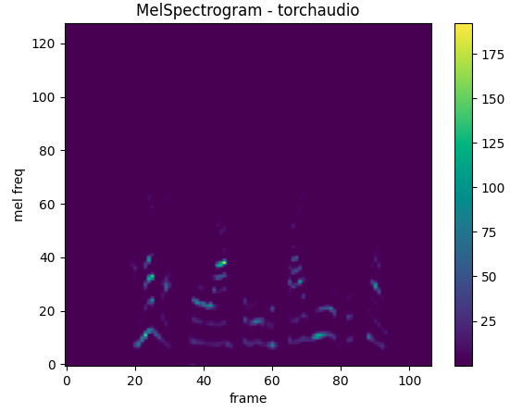
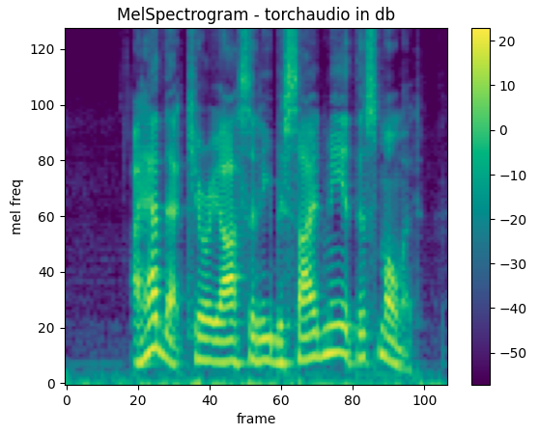
Week 8
Implemented torch Dataset class reading wav files and return melspectrogram in db. Use db instead of power because patterns are large enough to see the difference b/w melspectrograms

Slide 10
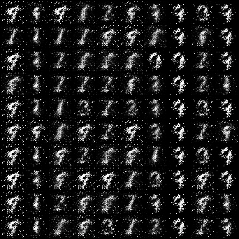
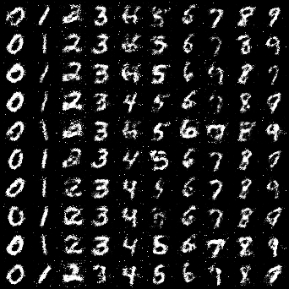
Week 8
Trained cGAN and cycleGAN using our dataset for 1M steps
Tested cGAN with MNIST dataset, it works well

Slide 11
Week 8
Trained cGAN and cycleGAN using our dataset for 1M steps
Tested cGAN with MNIST dataset, it works well
Using cGAN on our dataset with UNet and ResNet generator: it cannot generate anything
cGAN using UNet:
input
Step 40000
Step 990000
output

Slide 12


Week 8
Trained cGAN and cycleGAN using our dataset for 1M steps
Tested cGAN with MNIST dataset, it works well
Using cGAN on our dataset with UNet and ResNet generator: it cannot generate anything
cGAN using ResNet:
input
Step 20000
Step 820000
output

Slide 13
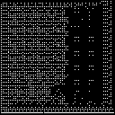

Week 8
Trained cGAN and cycleGAN using our dataset for 1M steps
Using cycleGAN on our dataset with UNet generator: it cannot generate anything too
input
Step 110000
Step 850000
output

Slide 14
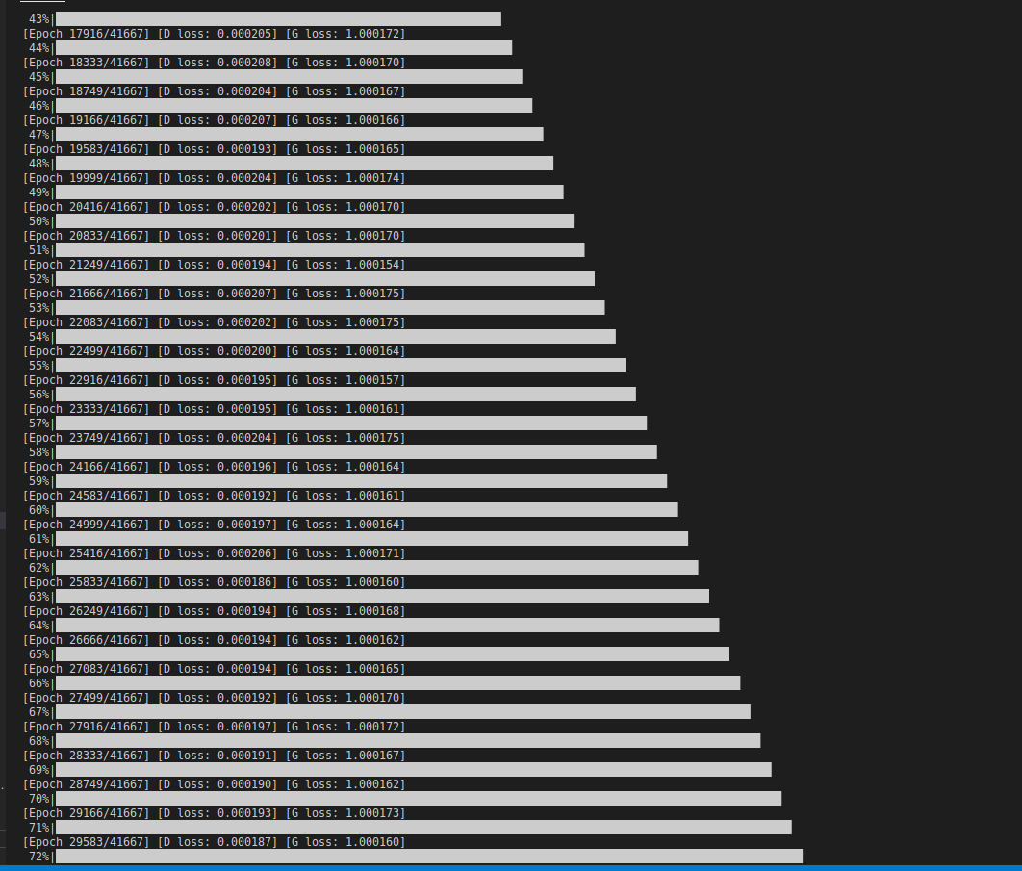
Week 8
Trained cGAN and cycleGAN using our dataset for 1M steps
Loss over every 10000 steps:

Slide 15
Week 9
Try:
For D: use encoder to focus more on context (can be ASR/voice conversion encoder) (not yet)
May change G encoder to match with our task
Injecting ASR context vector into G’s decoder (done)
Combine 1 and 2, similar to cVAE-GAN (Conditional Variational Autoencoder GAN)
Both G, D: get pretrained weights from speech enhancement/noise reduction/etc. tasks then finetune on our dataset (done)
Why cGAN and cycleGAN? Look at other types of GAN (not yet)

Slide 16
Weekly Report
(week 7-8)
Quan Nguyen

Slide 17
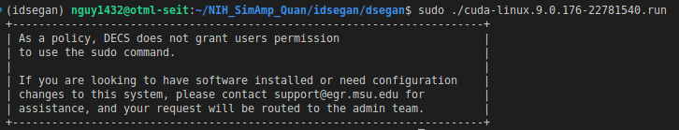
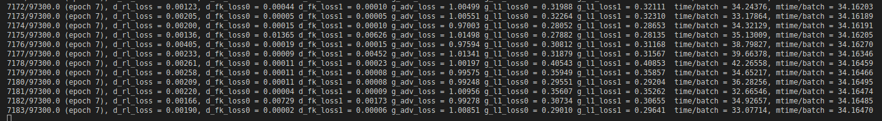
Week 7
Ran IDSEGAN in Tensorflow (Iterated SEGAN and Deep SEGAN):
Both cannot get the GPU for Tensorflow with suitable CUDA and cudnn, so the training is very slow
I tried to install CUDA 9 (compatible version for tf1.9) following guide from Medium, but the system does not allow using sudo command

Slide 18
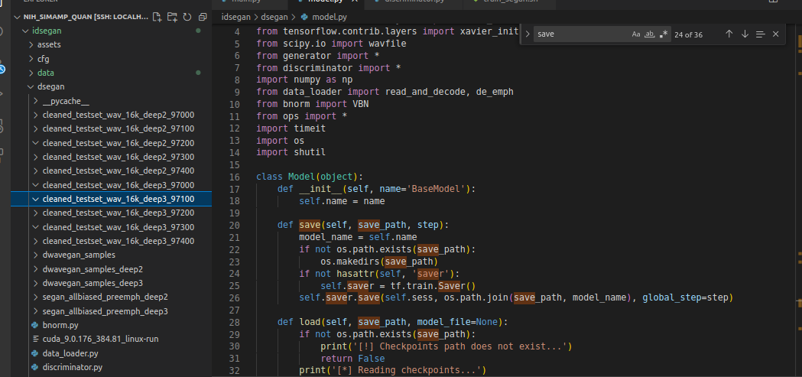
Week 7
Ran IDSEGAN in Tensorflow (Iterated SEGAN and Deep SEGAN):
Some issue with the checkpoint saving functions so that the weights cannot be saved

Slide 19
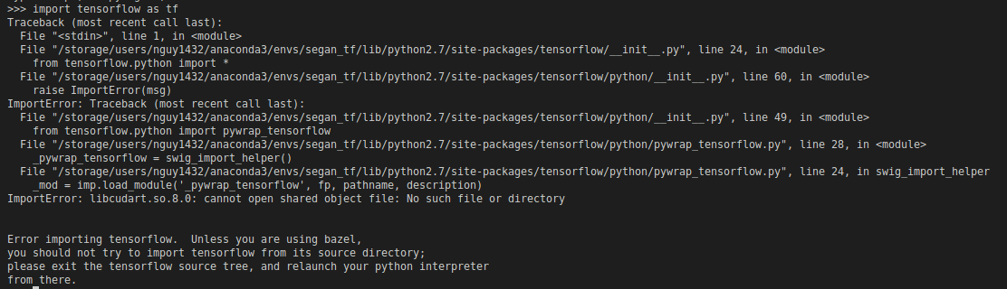
Week 7
Run SEGAN in Tensorflow instead of Pytorch version:
Appears error since the author used Python 2.7 with Tensorflow 0.12, which is too old. Thus, I could not import tensorflow

Slide 20
Week 8
Run IDSEGAN on desktop
Create diagram of our system for lab meeting/poster

Slide 21
Weekly Report
(week 6-7)
Quan Nguyen

Slide 22
Week 6
Generating ground-truth that has the voice similar to speaker’s voice
Last week was generating groundtruth with random vocal style
This week, I figured out why my previous attempt failed: data must be converted to 16kHz, then use pretrained model to extract vocal style of each speaker
Finetuned SEGAN on our dataset, there are 2 smaller steps, train SEGAN on noise-reduction dataset, then finetune that on our PD speech dataset since ours is very small (around 200 samples).
Train SEGAN on noise-reduction dataset: I trained for 90 epochs, but the result is quite bad, not the same as author’s pretrained model. I realized my learning rate (lr) is 10 times smaller than that mentioned in their paper, so I am training another with lr same as theirs
Train SEGAN on our PD dataset: the model does not work well enough so far

Slide 23
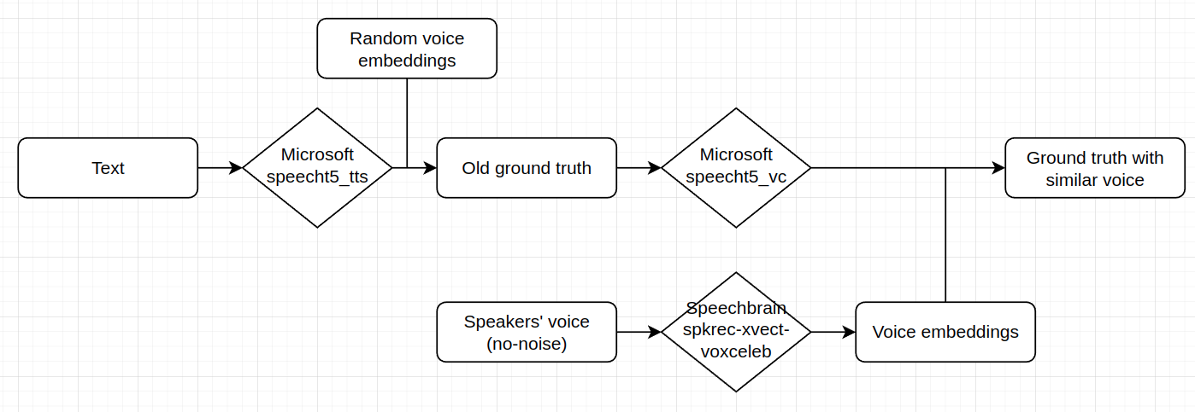
Generating ground-truth
Sample of new data: link

Slide 24
Finetuned SEGAN
Noise-reduction:
Their approach works on the wav data directly (without converting into spectrogram)
From author’s weight: here are some samples
Our weight trained on their dataset: here are some samples
Config: 90 epochs, lr=0.0002, Adam optimizer
PD speech:
Keep training on their pretrained weight, but on our dataset, including both non and amplified speech (total of around 200 files)
Result: cannot hear the speech well, here are some samples

Slide 25
Week 7
Re-train model with other hyperparameters, especially learning rate and optimizer (using Adam instead of RMSprop as in the paper) on both noise-reduction and PD speech datasets
Train Tensorflow version, check whether they provide G and D weights
Discuss with Yuanda and Hanqing to find alternative methods if SEGAN cannot perform well
Using 2D domain data

Slide 26
Weekly Report
(week 5-6)
Quan Nguyen

Slide 27
Week 5
Amplified the formants by frame based on Hanqing’s code for mean formants
Tried other methods of enhancement such as spectral shaping, sub-band spectral enhancement, but couldn’t improve the result.
Computed WER and CER on 2 scenarios: both pd and oc, only pd
Generated ground truth speech files using text-to-speech Microsoft’s SpeechT5 model (choosing the style randomly)

Slide 28
Week 6
Try to understand the label input and data as well as folder structure for SEGAN model
Finetuning SEGAN on our dataset
Discuss with Yuanda about separating context and style of speech and finetune SEGAN on that instead of using both context and style as first bullet point

Slide 29
Weekly Report
(week 4-5)
Quan Nguyen

Slide 30
Week 4
Read papers Yuanda suggested:
SEGAN: Speech Enhancement Generative Adversarial Network (code)
PHASEN: A Phase-and-Harmonics-Aware Speech Enhancement Network (code)
A Fully Convolutional Neural Network for Complex Spectrogram Processing in Speech Enhancement (code)
Find dataset (in case we need larger dataset to train/finetune model): Parkinson Speech Dataset with Multiple Types of Sound Recordings (from dataset list)
Discuss with Yuanda about model pipeline to enhance ASR for PD patient
Write evaluation pipeline on wavefiles using pretrained ASR model (OpenAI’s Whisper-medium) to avoid using commercial APIs (reduce expense on using them)

Slide 31
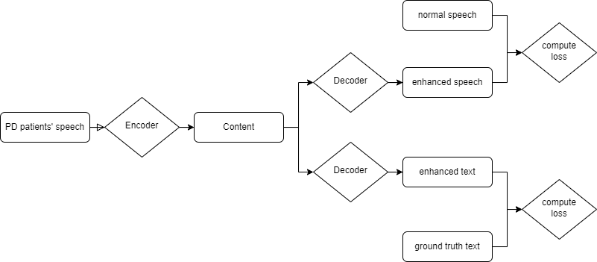
Week 5
Decide which pipeline to use to enhance to PD patients’ speech:
Issue: the pipeline is what I feel worried the most since Yuanda said the idea must be unique or have some innovations). Here is my idea. The target is to enhance speech, so both input and output must be audio/wavefiles, using both normal speech and normal text as ground truth to compute loss
After deciding the pipeline, I will choose models for:
Speech encoding
Speech decoding
Text decoding
Lastly, I will work on the data pipeline, dataset/dataloader for finetuning

Slide 32
Weekly Report
(week 3-4)
Quan Nguyen

Slide 33
Week 3
Improve ASR for patients with mental diseases:
Changed the project topic to modifying sound to improve commercial ASR for Parkinson’s patients
Met with Hanqing to continue his work, working on this project with Yuanda
Spent time getting use to Hanqing’s code
Find previous work relating to this topic
Find open-source models for each of 2 pipelines:
Speech Enhancement: SpeechBrain/
ASR

Slide 34
Week 4
Signal processing:
Read papers/materials about those methods
Try different methods to explore whether they help improving the performance
SpeechBrain:
Try with pretrain first
If does not work, then fine-tune it

Slide 35
Weekly Report
(week 2-3)
Quan Nguyen

Slide 36
Week 2
Paper presentation slides: Here is my Slides Presentation for 5 Papers:
Is Style All You Need? Dependencies Between Emotion And GST-Based Speaker Recognition
Style Tokens: Unsupervised Style Modeling, Control and Transfer in End-to-End Speech Synthesis
Mind the Style of Text! Adversarial and Backdoor Attacks Based on Text Style Transfer
Hidden Trigger Backdoor Attack on NLP Models via Linguistic Style Manipulation
Scale-up: An efficient black-box input-level backdoor detection via analyzing scaled prediction consistency
Implementation for Speech Recognition with attention:
After our meeting last Friday, we decided that the implementation of attention-based speech recognition is needed for our project.
Thus, I found a Pytorch implementation of speech recognition with attention-based RNN and transformers: SpeeQ (source code Github).
From the “Attention-Based Models for Speech Recognition,” their main contribution is the Location Aware Attention, which is build based on Seq2Seq model with RNN.

Slide 37
Week 3
Before meeting:
Determine research project: Type of attack: adversarial voice attack / Attack method / Metrics / Hardware needed to conduct those attacks / Choose the attacked model (intend to be attention-based speech recognition model)
Reimplement Seq2Seq model with RNN and Location Aware Attention for speech recognition (if Dr. Yan requires).
Stay in touch and start working with Yuanda.
After meeting:
Literature review:
Advantage of attn on speech recognition
How attn works in speech recognition
Attacks on attn mechanism
Characterizing Speech Adversarial Examples Using Self-Attention U-Net Enhancement
Universal Adversarial Attack on Attention and the Resulting Dataset DAmageNet
Attention Mechanism Based Adversarial Attack Against Deep Reinforcement Learning
Fooling Vision and Language Models Despite Localization and Attention Mechanism
Attention‐guided transformation‐invariant attack for black‐box adversarial examples
Attend and Attack: Attention Guided Adversarial Attacks on Visual Question Answering Models
Generating De-identification facial images based on the attention models and adversarial examples
Inheritance Attention Matrix-Based Universal Adversarial Perturbations on Vision Transformers
One-Shot Adversarial Attacks on Visual Tracking With Dual Attention
Seq2Sick: Evaluating the Robustness of Sequence-to-Sequence Models with Adversarial Examples
Universal Adversarial Triggers for Attacking and Analyzing NLP
Adversarial Regularization for Attention Based End-to-End Robust Speech Recognition
On Evaluation of Adversarial Perturbations for Sequence-to-Sequence Models
Give Me Your Attention: Dot-Product Attention Considered Harmful for Adversarial Patch Robustness
Learn more about Adversarial Attack:
Purdue University
Wiki

